Slide 1
Introduction to Web X.0
Module 1

Slide 2
Evolution of Web X.0

Slide 3





Web 1.0
It is 1st generation of the WWW.
Web 1.0 is one-way broadcasting, meaning only the owner of the site can publish information.
It was the content web, static information.
coined by Tim Berners-Lee as “read only” web
focus was on content delivery rather than interaction and production.
A system of internet servers that support specially formatted document by using HTML.

Slide 4
WWW is not synonymous with internet.
The Internet is a massive network of networks, a networking infrastructure. While WWW or simply Web, is a way of accessing information over the medium of the internet.
Internet connects millions of computers together globally. WWW is an information sharing model that is built on top of the browsers

Slide 5
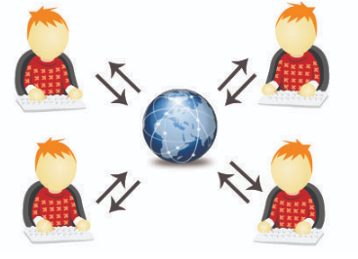






Web 2.0
It is 2nd generation of the www that focused on the ability for people to collaborate and share information online.
It signifies a conversation between the original author of the content and all those who can comment or participate.
wisdom, people-centric, participative, and read- write web
It refers to the transition form static HTML web pages to a more dynamic web.
It is also regarded as the social web. Eg: Wikipedia, facebook, youtube.

Slide 6
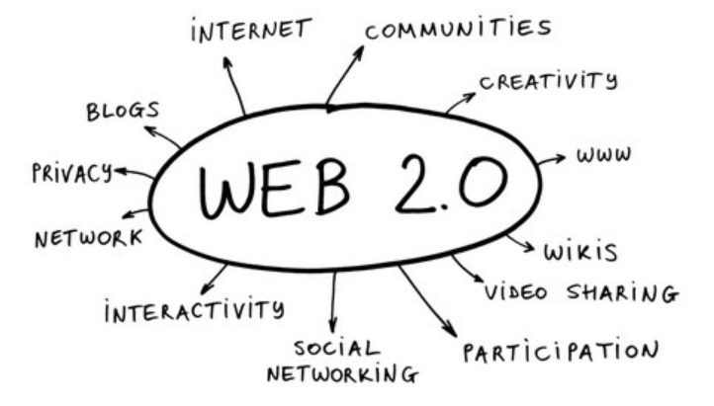
Web 2.0 is the business revolution in the computer industry caused by the move to the internet as platform
Recommendation Systems
But Security was an issue!

Slide 7





Web 3.0
Web 3.0 is an extension of Web 2.0.
Owning data with Decentralized web
Non-fungible tokens, or NFTs ( .nft, .crypto, .bitcoin, .x, .blockchain)
Records in Blockchain
Need not renew
Use for website, social media handle
decentralized hosting (IPFS)/ Serverless hosting
Introduces Security
Data on the web are Semantic based, rather than keyword
Notes:
https://influencermarketinghub.com/nft-domains/
https://www.youtube.com/watch?v=FaBxGDdJEC4

Slide 8
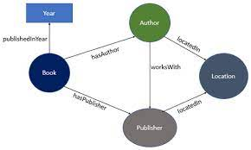
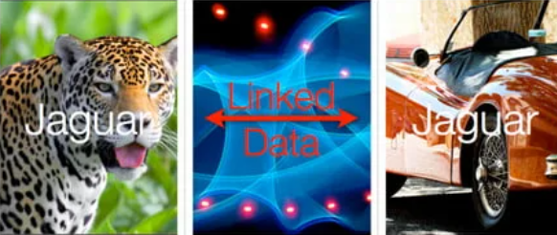




web 3.0 is also known as the “Semantic web”.
It includes several technologies in order to arrange and structure data you can find on the internet to make it available and usable by programs and software thanks to a metadata system.
The purpose is to make the web readable by machines and not only by humans.
It is also about language, or ontology, for recording how the linked data relates to real world objects, allowing a 'machine' to `understand' the semantic meaning and the difference between Jaguar (car) and jaguar (animal).

Slide 9
It starts with the Resource Description Framework (RDF) which gives the specifications of such a metadata data model. It is also the Web Ontology Language (OWL) and notations like RDF Schema (RDFS).

Slide 10
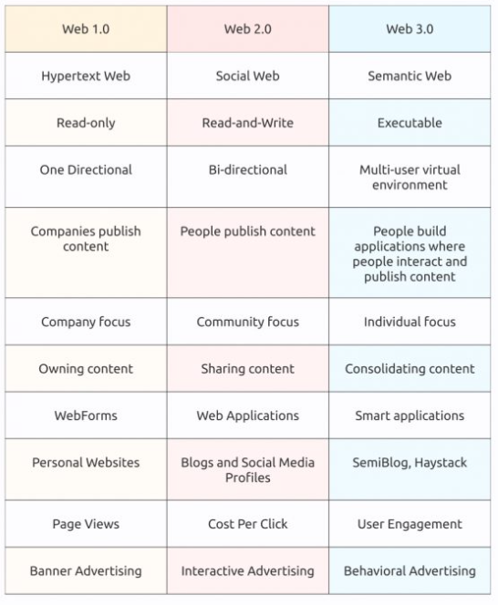

Slide 11










Web 4.0
Here is addition of more technology rather than only content
Connect device to humans
Machine Learning
VR
IOT/ Internet of Everything
Artificial Intelligence
Tools to make it more secure
Intelligent Web
Eg: facial recognition, an electronic agent will recognize users by their voice through an Internet-connected device, Personalized search, auto suggestion
Notes:
https://en.itpedia.nl/2018/11/12/web-4-0-the-internet-of-things-en-ai/

Slide 12


Web 4.0 also known as the Symbiotic web.
It will aim at the interaction between humans and machines in symbiosis. Humans and machines will have a symbiotic relationship, where machines will be capable of learning from human interactions and providing insights that can assist in decision-making.
In Web 4.0 services are autonomous, proactive, self-learning, collaborative, and content-generating agents.
Fully mature semantic and reasoning technologies, as well as AI are the foundation.
They use and support Web databases through intelligent agents.
Examples include services that interact with sensors and implants, natural language services, or virtual reality services.

Slide 13



Web 5.0
focus on empowering users to reclaim control and ownership of their data
Former Twitter CEO Jack Dorsey recently announced his vision for a new decentralized web platform that is being called Web 5.0 and is being built with an aim to return “ownership of data and identity” to individuals.
The Block Head (TBH). Web 5.0 is aimed at “building an extra decentralized web that puts one in control of ones’s data and identity”.
Notes:
https://www.drishtiias.com/daily-news-analysis/web-5-0
https://101blockchains.com/web-5-0/

Slide 14
linked, emotive and symbolic web that communicates with humans.
It is based on emotional association with humans, paving the way for more personalized experience, which will attract more people ever.
Eg: a personal assistant
think of possibilities with web 5.0 examples
such as a website that can map the emotions of a person.
The website can use facial recognition as a tool for mapping the person’s emotions when the user wears a headphone.
Users can interact with the website, and the website would respond accordingly based on emotions of the person.

Slide 15
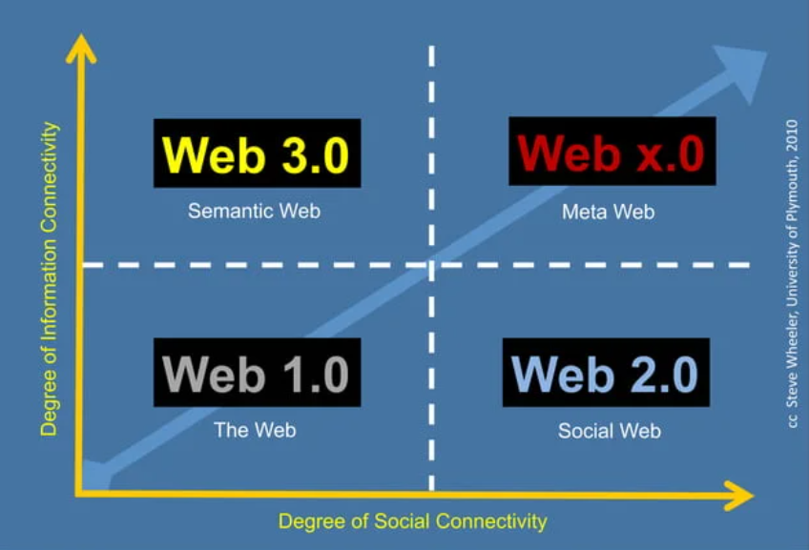

Slide 16
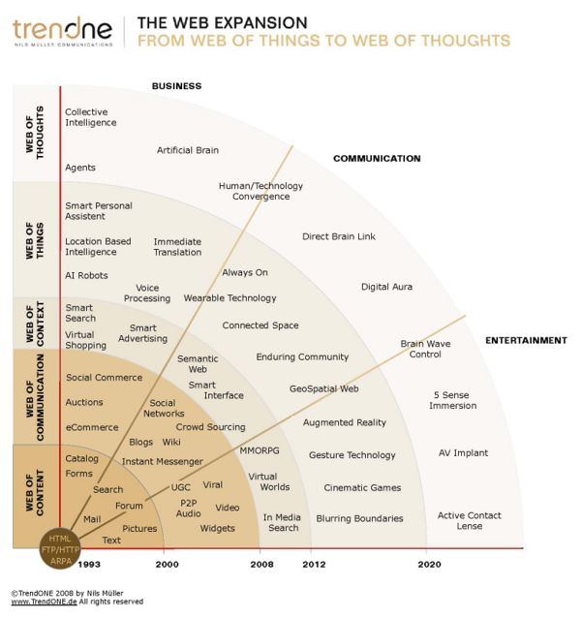

Slide 17
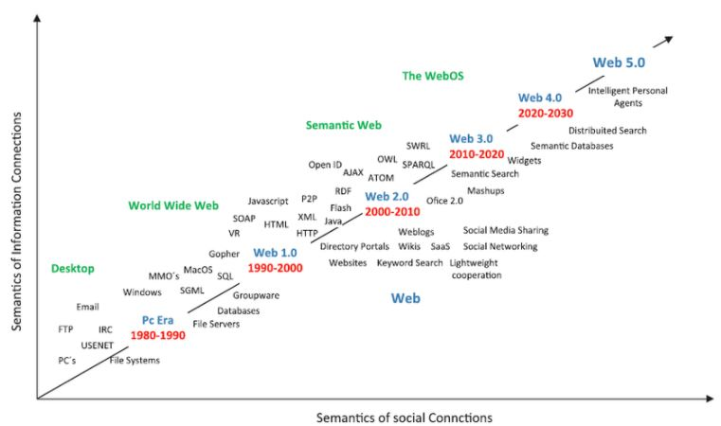
Notes:
http://myeltcafe.com/articles/evolution-of-web-from-1-0-to-5-0/
https://flatworldbusiness.wordpress.com/digital-evolution/

Slide 18
Web Analytics 2.0:

Slide 19
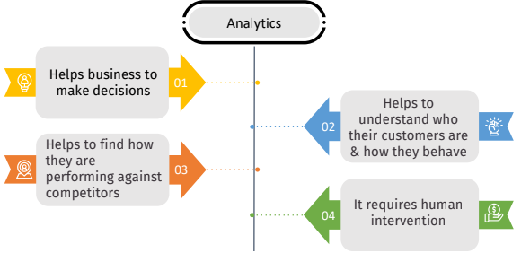
Web Analytics
Why analysis?
examination of the different parts or details of something
Break down and study for better understanding
What is Analytics?
Systematic computational analysis or Science of Analysis
Why Web Analysis?

Slide 20




Web analytics allow an organization to measure, collect, and analyze data from the visitors of an organization’s website.
Web analytics is used primarily for marketing research.
You can view the effectiveness of your website and exactly where the traffic is coming from.
You can also screen the results of different types of advertising.
Web analytics is used to boost your nonprofit organization’s brand.
It is a way to analyze your website’s usage statistics in order to better reach your target audience, and customize web content to their needs.

Slide 21

In all ……
Understanding user behavior. Website analytics tools can provide insights into user behavior, highlighting popular areas of a site and identifying pain points for users.
Identifying opportunities for improvement. By analyzing data from website analytics tools, it is easier to identify opportunities for improving user experience. This includes optimizing content for search engines, improving the overall functionality of the site or adjusting layout or design.
Measuring the effectiveness of marketing efforts. With website analytics tools it’s more simple to measure the effectiveness of marketing efforts, such as email campaigns or social media posts.
Notes:
https://blog.uxtweak.com/website-analytics-tools/

Slide 22
You can track the number of visitors and conversions from your social media channels to identify the most successful marketing strategy and allocate resources accordingly. To generate more follows from target customers on social media you can also make a custom QR code that will be shared with potential clients.
Setting and tracking goals. Website analytics tools allow you to set and track specific goals for your website, such as increasing the number of conversions or improving the average time spent on the site. By regularly reviewing data from these tools, it is possible to measure the progress toward these goals and identify areas for improvement.

Slide 23
Paradox of data: a lack of it means you cannot make complete decisions, but even with a lot of data, you still get an infinitesimally small number of insights.
Tools from Google Analytics, omniture sitecatalyst, webtrends, clicktracks or Xiti

Slide 24
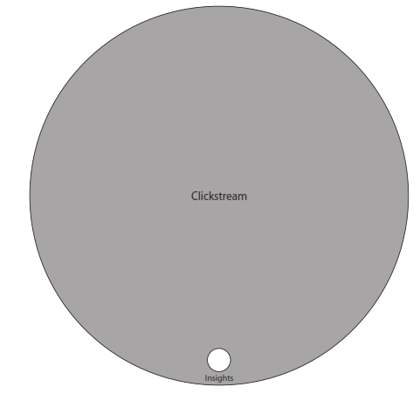
Rethinking Web Analytics: Meet Web Analytics 2.0
The old paradigm of Web Analytics 1.0
limits of clickstream data
we have the what:
what pages did people view on our website?
what products did people purchase?
what was the average time spent?
what sources did they come from?
what keywords or campaigns produced clicks?
what this, and what that, and what not?
But what data is missing the why………..

Slide 25

The Awesome World of Clickstream Analysis: Metrics
exploring the awesome world of Clickstream analysis with the building blocks of metrics and key performance indicators (KPIs).
The Critical Eight:
Visits: Someone came to the website. Also sometimes called a session.
Unique Visitors: An approximation of the number of people who have visited the site. Not a perfect measure; it assumes each visitor is an individual. Also must be carefully parsed to not count each visitor multiple times over a given period; metrics vendors must account for this, and it is a computational expense.
Time on Page: Time spent on an individual page. Difficult to measure; metrics vendors must adjust code to measure this.
Notes:
https://kirby5185.wordpress.com/2011/11/13/week-12-kaushik/
http://www.ques10.com/p/39549/54-the-awesome-world-of-click-stream-analysis-me-1/

Slide 26
Time on Site: Total time spent on the site during a session, related to Time on Page. Has the same issues as Time on Page.
Bounce Rate: Percentage of sessions spent on a site with a single page view. Not a positive metric; it means that people are not satisfied and leave immediately. Can be used to find bad pages on your site, and determine which referring sites and search terms are not working. Note an exception for blogs
Exit Rate: How many people left the site from a certain page. Everyone has to leave eventually, so Bounce Rate is better metric for that. But the related “Abandonment Rate” can measure users who complete a multipage task.

Slide 27
Conversion Rate: Mathematically, it’s Outcomes/Unique Visitors (or Visits). Used by ecommerce sites to determine if people are buying, buying after multiple visits, or just looking.
Engagement: The depth of the visit, impossible to gauge without surveys (especially the question of “likely to recommend”).

Slide 28
Web Analytics 2.0 is:
the analysis of qualitative and quantitative data from your website and the competition,
to drive a continual improvement of the online experience that your customers, and potential customers have,which translates into your desired outcomes (online and offline).
Web Analytics 2.0 answers
What is happening on my website?
What are the outcomes?
Why is it happening?
Competitor Analysis
What actions should be taken?

Slide 29
The What: Clickstream
what is collecting, storing, processing, and analyzing your website’s click-level data
it helps you measure pages and campaigns and helps you analyze all kinds of site behavior: Visits, Visitors, Time on site, PageViews, Bounce rate, sources, and more.
click-level data is data you get from Webtrends, Google Analytics, and other clickstream tools.
you will have a lot of data—in the order of gigabytes in a few months and more if you store history.
Notes:
https://framethink.wordpress.com/2007/11/16/avinash-kaushiks-five-levels-of-web-analytics-20/

Slide 30
The How Much: Multiple Outcomes Analysis
If the reports don’t focused on measuring outcomes, then it is of no use
focusing deeply and specifically on measuring outcomes means connecting customer behavior to the bottom line of the company.
Tie outcomes to profits and to the bonuses of your report recipients.
A website attempts to deliver just three types of outcomes:
increase revenue.
reduce cost.
improve customer satisfaction/loyalty.

Slide 31
Having clearly defined website goals is necessary and a great starting point, but not sufficient for true user insight.
Analysts should recognize that users and companies may have many different reasons for visiting or hosting a website
All those objective outcomes need to be measured to see if the site is really driving the desired outcomes

Slide 32
The Why: Experimentation and Testing
you can run experiments live on your site with various ideas and let your customers tell you what works best
Failing online is cheap and fast!
Testing online - different promotional offers via email or search ads before you finalize your strategy and launch it using print, catalog, or TV ads
Tools: Google website optimizer, Omniture’s Test&Target, Autonomy’s Optimost, Sitespect

Slide 33
Some testing techniques
A/B testing - Test the design of your website, including text, graphics, buttons, banner ads, everything.
Google Website Optimizer - Automates the process of running multivariate tests to help you quickly find the optimal.

Slide 34
The Why: Voice of Customer
your web analytics tool can report only what it can record. what your customers wanted but did not see was not recorded.
ask website visitors through surveys:
(1) why are you here?;
(2) were you able to achieve what you came for?;
(3) if not, why not? The results can be tied back to analytics data and may reveal customers’ true motivations.

Slide 35
The What Else: Competitive Intelligence
Knowing how you are performing against your competition - helps you improve, it helps you identify new opportunities, and it helps you stay relevant
Your competitors may be running campaigns or launching products/features that are impacting your site’s performance (could be either up or down).

Slide 36
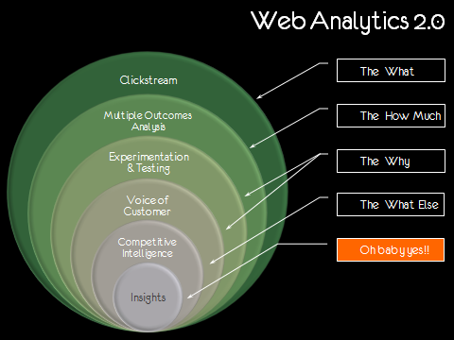
Web Analytics 2.0.
Clickstream answers the what.
Multiple outcomes Analysis answers the how
Experimentation and Testing and Voice of customer help explain the why
competitive intelligence answers the what else

Slide 37
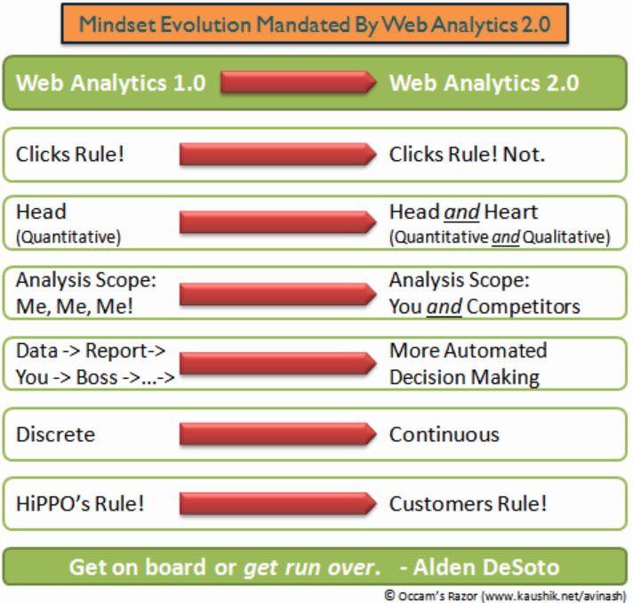
Strategic Shift with Web Analytics 2.0

Slide 38
Digital Analytics
• Digital Analytics is the science of analysis with focus on Internet data.
• Source : Website – Web Analytics, Mobile apps, Social Media, Third party sources
• It is the analysis of quantitative and qualitative data, to gain insights and drive
continual improvement.
• Big Data, Cloud and Diagnostic Analytics are the trends in Digital Analytics

Slide 39
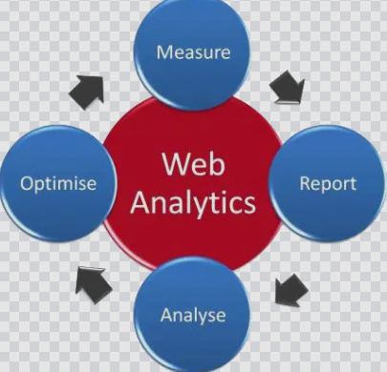
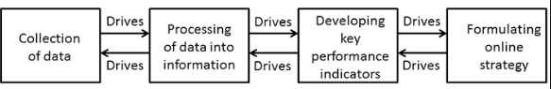
Web Anaytics is the measurement, collection, analysis and reporting of Internet data for the purpose of understanding and optimizing web usage

Slide 40
How to Choose a Web Analytics Tool:
Collect business requirement
Collect technical requirements
Documentation
Prepare Request for Proposal (RFP)
Send RFP to Vendor
Analyse reply
Select one vendor
Implement
Notes:
https://www.kaushik.net/avinash/how-to-choose-a-web-analytics-tool-a-radical-alternative/
https://www.newmediacampaigns.com/blog/website-design-request-for-proposal-template-tips

Slide 41

Collect business requirement
support both your existing and future business requirements.
Find core objectives of your business and create a list of your desired business outcomes. Next, break down your business objectives into measurable analytics goals.
Business Objectives like - goals, strategy, KPI's, reports, reporting schedule and so on
Decide what exactly it is you want to track and improve in your business.

Slide 42
Some of the metrics you might want to measure include website traffic, online sales, SEO ranking, sales lead quality, customer engagement, subscriber growth, inbound links and time spent on site.
choose a web analytics software that can provide the data you need for your business. In addition, the solution should be scalable to accommodate the future growth and expansion of your business.

Slide 43


Collect technical requirements
site architecture, servers, scripts, pages, IT needs and so on
Documentation
All who need to access the web analytics data should be contacted (inside and outside the company)
Document their needs
Prepare Request for Proposal (RFP)
A Request for Proposal is a document that solicits proposal, often made through a bidding process, by an agency or company interested in procurement of a commodity, service, or valuable asset, to potential suppliers to submit business proposals

Slide 44
Put up all the business and technical requirements along with vendors financial stability
Send RFP to Vendor
Send RFP to Vendor and set a schedule for reply
Analyse reply
Check feasibility
How much support will you need during the tool evaluation phase, start-up and maintenance?
Is there a downloadable evaluation version or hosted demo available for a trial period?

Slide 45
Verify if start-up or maintenance support is part of the package or incremental.
What amount of technical support and problem response will you need?
Is ongoing or more advanced training available?
Is training available online anytime or periodically in person?
Select one vendor who meet your requirements
Implement the tool

Slide 46
The Optimal Strategy for Choosing Your Web Analytics Soul Mate
Tools are Data rich but information poor, we need an analyst
Follow 10/90 rule
for every $10 you spend on your analytics tool and implementation, you should spend $90 on intelligent digital analysts who can convert your data into actionable insights
Step 1: Three Critical Questions to Ask Yourself Before You Seek an Analytics Soul Mate!
“Do I want reporting or analysis?”
“Do I have IT strength, business strength, or both?”
“Am I solving just for Clickstream or for Web Analytics 2.0?”
Notes:
http://www.ques10.com/p/39550/55-the-optimal-strategy-for-choosing-your-web-an-1/

Slide 47
Step 2: Ten Questions to Ask Vendors Before You Marry Them
“What is the difference between your tool/solution and free tools from Yahoo! and Google?”“ Are you planning a software version? ”
“What data capture mechanisms do you use?”
“Can you calculate the total cost of ownership for your tool?”
“What kind of support do you offer? What do you include for free, and what costs more? Is it free 24/7?”
“What features in your tool allow me to segment the data?”
“What options do I have for exporting data from your system into our company’s system?”
“Why did the last two clients you lost cancel their contracts? Who are they using now?

Slide 48
Step 3: Identifying Your Web Analytics Soul Mate (How to Run an Effective Tool Pilot)
Usability:
Determine the accessibility/intuitiveness of the tool.
Establish whether your target audiences (for example, business, data analyst, and IT) can actually use and customize the tool set and reporting or whether you must get dedicated resources to create the necessary reporting and dashboards on their behalf.
Get a feel for the extent of training needed.

Slide 49
Functionality
Test the functionality in realistic business situations: does it really do what it said on the tin?
Can you use out-of-the-box reports/features and page tagging, or do you need to customize and extend data collection to meet your needs? (You may need to run a handful of scenarios with vendors.)
Test potential interoperability with your other systems/data sources.
Step 4: Negotiating the Prenuptials: Check SLAs for Your Web Analytics Vendor Contract

Slide 50



The Key to Glory:Measuring Success
Actionable Outcome KPIs
Key Performance Indicators (KPI) are financial and non-financial metrics used to help an organization define and measure progress toward organizational goals.
Most important measures are: outcomes / conversions
Implement your Goals in the web analytics tool
Focus on the critical few - 2 to 4 metrics - most important factors for your business
Notes:
https://www.kaushik.net/avinash/rules-choosing-web-analytics-key-performance-indicators/

Slide 51











Key Performance Indicators (KPIs) for business:
Task Completion Rate - is the percentage of Visitors to your website who rate if they were able to complete the primary purpose for their visit.
Share of Search - is the percentage of traffic you get from search engines compared to your key competitors.
Visitor Loyalty and Recency - Visitor Loyalty measures the distribution of the number of Visits by each Visitor to your site. Recency measures the gap between two Visits by the same Visitor.

Slide 52


RSS/Feed Subscribers - measures the raw number of people who have signed up for your website or blog’s RSS (really simple syndication) feed.
% of Valuable Exits - measures the percentage of people who leave your website by clicking something of value to you.

Slide 53
For ecommerce site use the following Abandonment Rate metrics
Cart Abandonment (percentage) This is 1 minus (the total Visitors who start checkout divided by the total number of add to cart clicks).
Checkout Abandonment (percentage) This is 1 minus (the total Visitors who complete checkout divided by the total number of people who start checkout).
Days and Visits to Purchase - Days to Purchase shows the distribution of the number of days it takes someone to make a purchase on your website. Visits to Purchase shows the number of Visits until purchase.

Slide 54
Average Order Value - It’s the total amount of revenue divided by the total number of orders received.
Primary Purpose - Identify the Convertible - Opportunities
Measuring Macro (targeted/main) and Micro (other) Conversions Examples
Technical Support Website
Macro - Task Completion Rate
Micro - Call Avoidance, Content Consumption, Tickets Opened, Sales, Net Promoters
Multipurpose Ecommerce Website
Macro - Completed orders
Micro - Visitors create accounts, software downloads, Contact Us

Slide 55


Measuring success for Non-Ecommerce Website (news website or a blog or an academic journal website)
Visitor Loyalty - Visitor Loyalty tells you how often Visitors visit your website during the reporting period. Matric - average Visits per visitor.
Visitor Recency - Visitor Recency tells you how long it has been since a visitor last visited your website
Length of Visit - Length of Visit measures the quality of visit as represented by the length of a visitor session in seconds.
Depth of Visit - Depth of Visit measures the distribution of the number of pages in each Visit to the website, during a given reporting period.

Slide 56
Measuring success for B2B website
Percentage of Visits that viewed the Product Folder directories
Percentage of selection and solution guide downloads
Number of free samples ordered
Number of new accounts opened
Number completed videos watched
Percentage of solutions posted by the same member ID
Usage of decision support tools

Slide 57
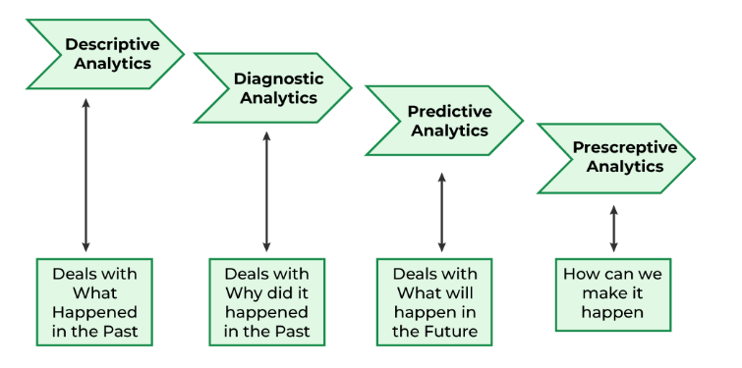










Different Types of Analytics
Understanding and leveraging different types of analytics provided added value to a business to improve its organization-level operational capabilities.
Choosing the right forms of data, analytics can make most of the unstructured or structured data they own
Types of Analytics
Descriptive
Diagnostic
Predictive
Prescriptive.
Notes:
https://www.geeksforgeeks.org/data-analytics-and-its-type/

Slide 58



Descriptive Analytics ( What happened?)
Descriptive analytics is the branch of analytics that involves the interpretation and summarization of historical data to understand what has happened in the past.
This is the baseline and the place that all organizations should start
It looks at the events of the past and tries to identify specific patterns within the data.
Visualizations commonly used for Description Analytics include pie charts, bar charts, tables, or line graphs.

Slide 59
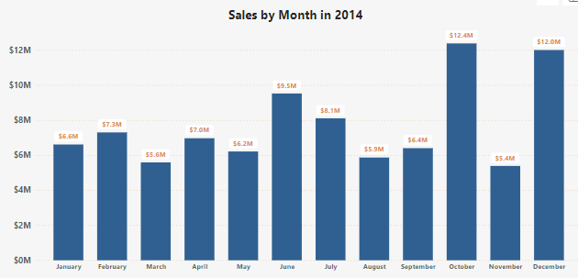
The chart below shows sales from 12 months through this we can identify the trend of sales.
Observe increase in sales in October and December, with a decrease in November.

Slide 60





Diagnostic Analytics (Why did it happen? )
This is a form of advanced analytics that examines data or content to answer the question, “Why did it happen?”.
This is the second step as you must first understand what happened to be able to identify why it happened.
Once an organization achieves descriptive insights, they can apply diagnostics with a little more work.
It is characterized by techniques such as drill-down, data discovery, data mining, and correlations.
Example you hover over you can see a breakdown by segment. You can now see which segments contributed the most to an increase in sales.

Slide 61
(with reference to example in slide 40)
Diagnostic Analysis:
Explore factors that may have influenced variations in sales performance. For example, analyze marketing campaigns, promotions, or external events that coincided with peaks or drops in sales.
Reporting:
Generate a monthly sales performance report that includes visualizations and key insights. Share this report with stakeholders, including executives, marketing teams, and sales teams.

Slide 62




Predictive Analytics ( What is likely to happen? )
Once an organization can effectively understand what occurred and why it happened, they can move up to the next tier in analytics, Predictive.
Predictive Analytics is another type of advanced analytics that looks to use data and information to answer the question “What is likely to happen?”.
Predictive Analytics involves techniques such as regression analysis, forecasting, multivariate statistics, pattern matching, predictive modeling, and forecasting.
These techniques are harder for organizations to accomplish as they require large amounts of high-quality data. Additionally, these techniques require a deep understanding of statistics and programming languages such as R and Python.

Slide 63
(with reference to example in slide 40)
Once validated, use the trained model to make predictions for future monthly sales performance. This involves inputting relevant data for upcoming months into the model to generate forecasts.
Predictive Model will suggest the impact of the next marketing campaign on customer engagement using historical data.
Conduct scenario analyses by adjusting input variables to observe how changes in factors like marketing spend or promotions might impact future sales predictions.

Slide 64




Prescriptive Analytics ( What should be done? )
The final level and most advanced level of analytics and most difficult level to achieve
Prescriptive Analytics is a method of analytics that analyzes data to answer the question “What should be done?”.
Characterized by techniques such as graph analysis, simulation, complex event processing, neural networks, recommendation engines, heuristics, and machine learning.
involves using data, algorithms, and business rules to recommend actions that can optimize or improve future outcomes.

Slide 65
The reliability of Prescriptive Analytics depends heavily on the accuracy of
how well an organization as has accomplished each level of analytics.
quality of data
appropriate data architecture to facilitate it and the expertise needed to implement this architecture.
The value that it brings is that an organization will be able to make decisions based on highly analyzed facts rather than instinct.
Meaning they are more likely to guarantee the desired result, such as increasing revenue.

Slide 66
(with reference to example in slide 40)
Scenario 1: If the predictive model suggests a potential drop in sales due to decreased marketing effectiveness, the prescriptive analytics recommends increasing marketing spend for targeted campaigns.
Scenario 2: If the model predicts a surge in demand for a particular product category, the prescriptive analytics recommends optimizing inventory levels for those products.
By applying prescriptive analytics to monthly sales performance analysis, businesses can move beyond merely predicting future outcomes to actively recommending the best actions to achieve desired results.

Slide 67
Web3.0 and Semantic Web

Slide 68




• The development of Semantic Web is well underway with a goal that it would be possible for machines to understand the information on the web rather than simply display.
• The major obstacle to this goal is the fact that most information on the web is designed solely for human consumption. This information should be structured in a way that machines can understand and process that information.
• The key technological threads that are currently employed in the development of Semantic Web are: eXtensible Markup Language (XML), Resource Description Framework (RDF), DAML (DARPA Agent Markup Language).

Slide 69

The concept of machine-understandable documents does not imply “Artificial Intelligence”. It only indicates a machine’s ability to solve well-defined problems by performing well-defined operations on well-defined data.
Most of the web’s content today is designed for humans to read , and not for computer programs to process meaningfully.
Computers can
parse the web pages.
perform routine processing (here a header, there a ink, etc.)

Slide 70
In general, they have no reliable way to understand and process the semantics.
• The Semantic Web will bring structure to the meaningful content of the web of web pages, creating an environment where software agents roaming from page to page carry out sophisticated tasks for users.
The Semantic Web is not a separate web.
Tim Berner Lee’s idea
To unlock the potential of the web
Link data and relation between the data
Web of data rather than Web of Documents

Slide 71
Tim Beerner’s 3 Rules of Semantic Web
A URI should point to the data.
Anyone accessing the URL should get data back.
Relationships in the data should point to additional URLs with data.
Berners-Lee et al. describe the Semantic Web as “an extension of the current web in which information is given well-defined meaning, better enabling computers and people to work in cooperation.”
Information is structured in a way that computers can draw relationships between resources.
Those relationships are what is known as linked data.
Notes:
https://en.wikipedia.org/wiki/Semantic_Web#:~:text=Berners%2DLee%20posits%20that%20if,URL%20should%20get%20data%20back.

Slide 72
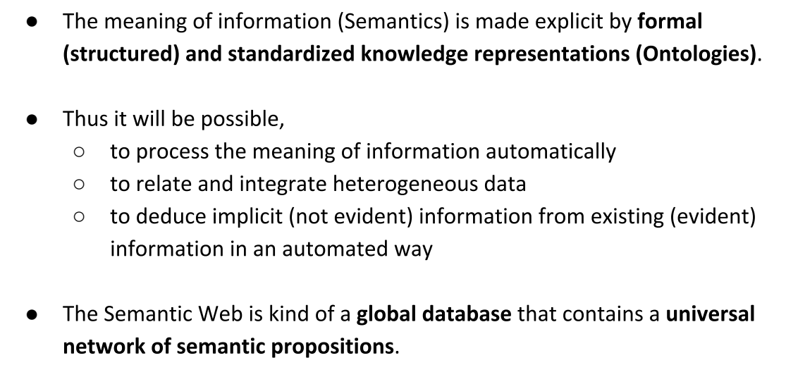
The Semantic Web - the Web of Data

Slide 73
three main topics that provide conceptual underpinnings for the Semantic Web:
Building models: the quest for describing the world in abstract terms
to allow for an easier understanding of a complex reality.
Computing with knowledge: the endeavor of constructing reasoning ma-
chines that can draw meaningful conclusions from encoded knowledge.
Exchanging information: the transmission of complex information re-
sources among computers that allows us to distribute, interlink, and reconcile knowledge on a global scale.

Slide 74
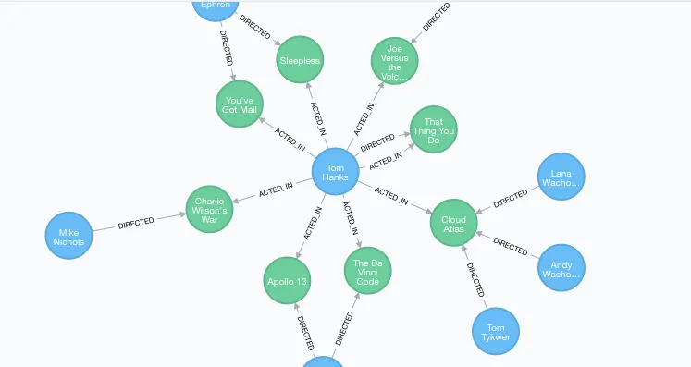
Linked Data
Define relationship between data
Enable accessibility and integration of different datasets on the Web
Using a standard format for data and relationship: Linked Data triples
Notes:
https://pitt.libguides.com/metadatadiscovery/linked-data

Slide 75
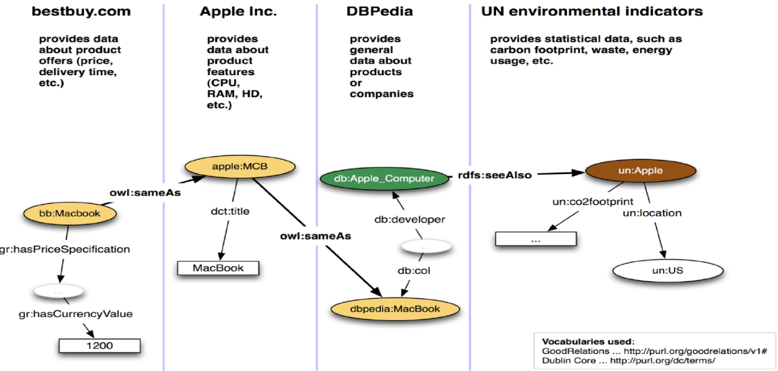
Notes:
https://uic.org/events/IMG/pdf/2_uic-digitaldays_semanticweb_dg_2019-10-02d.pdf

Slide 76
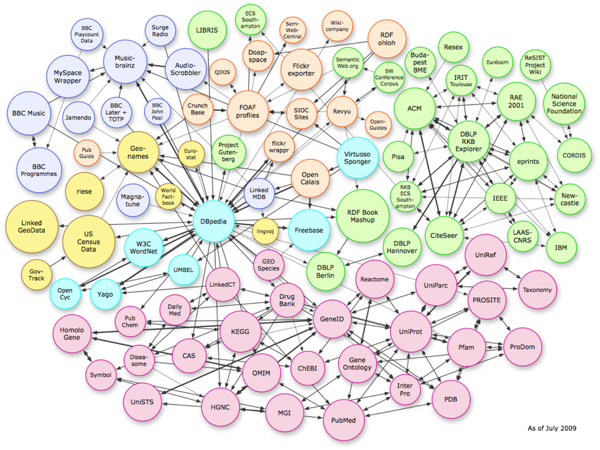

Slide 77
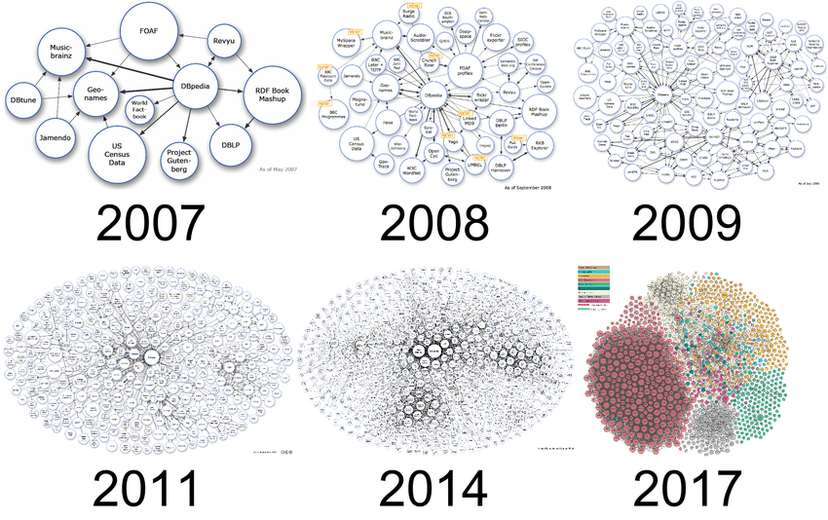
It gets bigger

Slide 78
Semantic Web allows machines to make inferences
Linked data enables for
New relationships between data can be created automatically
Analysing the content of new data
Discovering potential inconsistencies

Slide 79
Vocabularies
Basic building blocks for making Inference
Helps to resolve ambiguity between different datasets, define new relationships, organize Knowledge.
Ontology and Vocabulary are used interchangeably, generally Complex is referred as Ontology and simpler ones Vocabulary
Eg: A bookseller may want to integrate data coming from different publishers. The data can be imported into a common RDF model, eg, by using converters to the publishers’ databases. However, one database may use the term “author”, whereas the other may use the term “creator”. To make the integration complete, and extra definition should be added to the RDF data, describing the fact that the relationship described as “author” is the same as “creator”.
Notes:
https://www.w3.org/standards/semanticweb/ontology

Slide 80
Semantic Web is…..
Assembles data from many authoritative sources in ONE place
Standardized data collections for improved access and collaboration
Allows computers to understand the meaning of data, enabling humans to work more effectively
Characterised as
Machine-interpretable, structured, interlinked, open access data repositories
Globally edited adaptive information resources
Unique web resource identifiers for every bit of information (e.g., each table data cell of a table has a unique identifier)

Slide 81
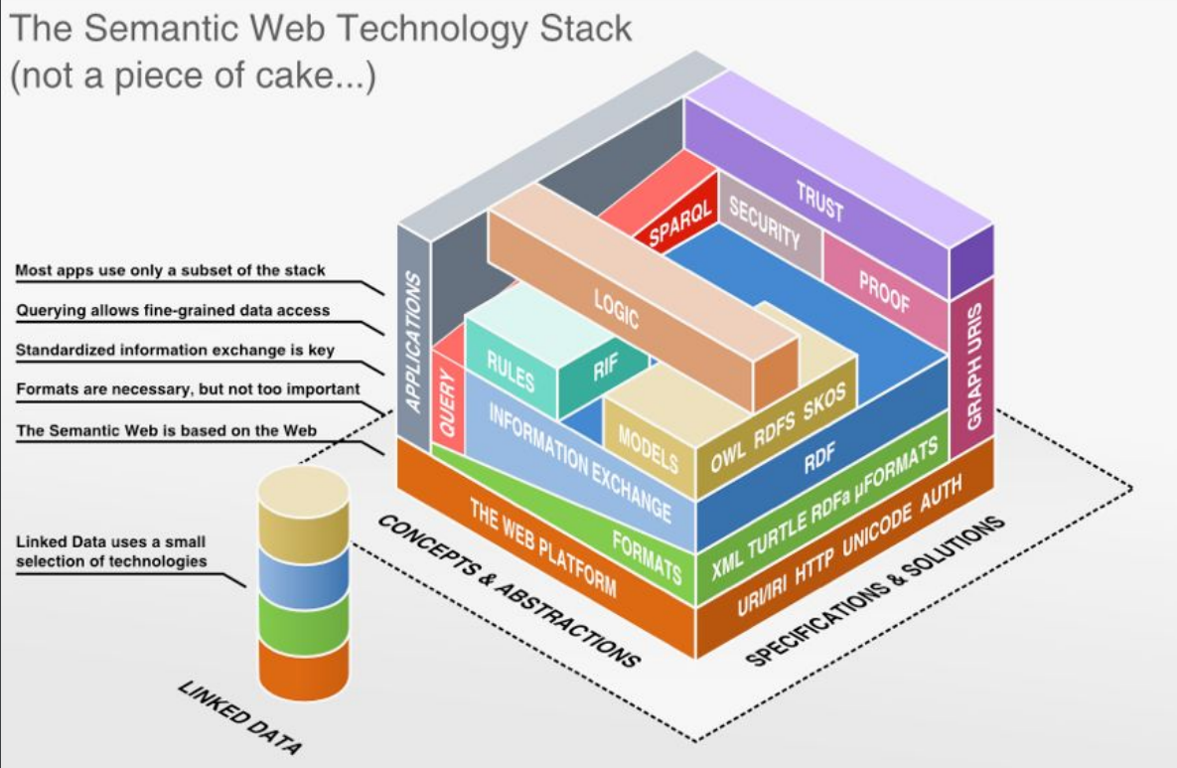
Semantic Web Stack
Notes:
https://open.hpi.de/courses/semanticweb2015/items/QEiaiqA9EKGDkqUuGa4ue

Slide 82
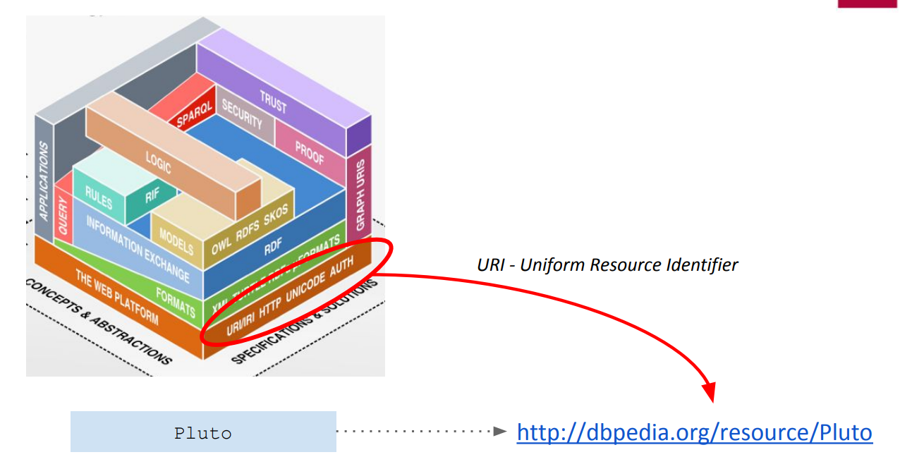
URIs and Unicode.
URIs (uniform resource identifiers) are unique identifiers for resources of all types—from schemas to people. A major component of the base layer, URIs are metadata (eg:ISBNs (international standard book numberrs) or Social Security numbers in the context of the Web.
Notes:
https://en.wikipedia.org/wiki/Pluto
https://dbpedia.org/page/Pluto

Slide 83
RDF and RDFschema.
RDF is a formal language for describing structured information.
enable applications to exchange data on the Web while still preserving their original meaning.
As opposed to HTML and XML, the main intention now is not to display documents correctly, but rather to allow for further processing and re-combination of the information contained in them.

Slide 84
RDF is one of the main building bloksAll knowledge is stored in the form of RDF triples
The RDF family further supports interoperability at the semantic level so that agents, can make logical inferences, based on metadata, to perform tasks.

Slide 85
Knowledge about the entities is expressed usually in relation with other entities, hence a Model
Schema Definition

Slide 86
Ontology vocabulary
formal description of knowledge as a set of concepts within a domain and the relationships that hold between them
contains simple descriptive to complex classificatory schemas are to be created and registered so that agents can intelligently interpret data, make inferences, and perform tasks.

Slide 87
components such as individuals (instances of objects), classes, attributes and relations as well as restrictions, rules and axioms
ontologies do not only introduce a sharable and reusable knowledge representation but can also add new knowledge about the domain
ontology data model can be applied to a set of individual facts to create a knowledge graph
a collection of entities, where the types and the relationships between them are expressed by nodes and edges between these nodes
Notes:
https://www.ontotext.com/knowledgehub/fundamentals/what-are-ontologies/

Slide 88
provide users with the necessary structure to link one piece of information to other pieces of information on the Web of Linked Data.
they specify common modeling representations of data from distributed and heterogeneous systems and databases, ontologies enable database interoperability, cross-database search and smooth knowledge management.
Notes:
https://www.ontotext.com/knowledgehub/fundamentals/what-are-ontologies/

Slide 89
OWL
ontologies using ontology languages such as the Web Ontology Language (OWL)
OWL is a semantic web computational logic-based language, designed to represent rich and complex knowledge about things and the relations between them

Slide 90
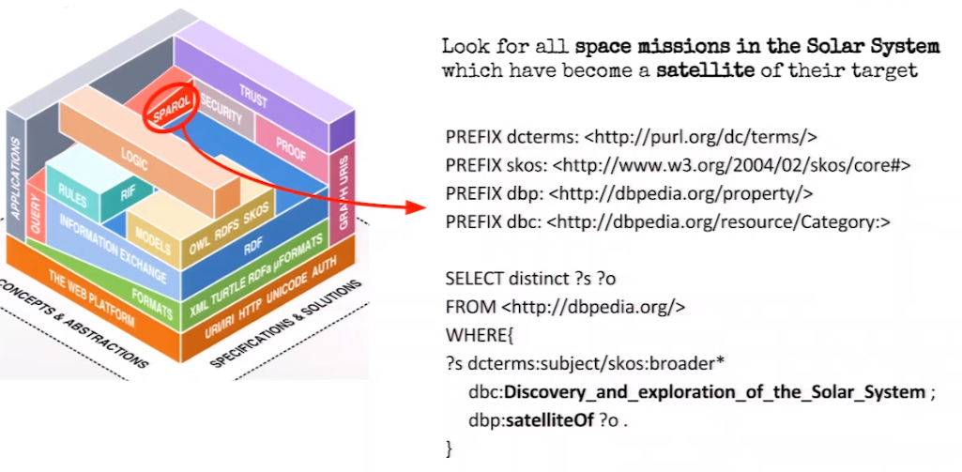
SPARQL
Notes:
https://dbpedia.org/sparql?default-graph-uri=http%3A%2F%2Fdbpedia.org&qtxt=PREFIX+dcterms%3A+%3Chttp%3A%2F%2Fpurl.org%2Fdc%2Fterms%2F%3E%0D%0APREFIX+skos%3A+%3Chttp%3A%2F%2Fwww.w3.org%2F2004%2F02%2Fskos%2Fcore%23%3E%0D%0APREFIX+dbp%3A+%3Chttp%3A%2F%2Fdbpedia.org%2Fproperty%2F%3E%0D%0APREFIX+dbc%3A+%3Chttp%3A%2F%2Fdbpedia.org%2Fresource%2FCategory%3A%3E%0D%0A%0D%0ASELECT+distinct+%3Fs+%3Fo+%0D%0AFROM+%3Chttp%3A%2F%2Fdbpedia.org%2F%3E%0D%0AWHERE%7B%0D%0A%3Fs+dcterms%3Asubject%2Fskos%3Abroader*++dbc%3ADiscovery_and_exploration_of_the_Solar_System+%3B%0D%0A+++++dbp%3AsatelliteOf+%3Fo+.%0D%0A%7D+%0D%0A&format=text%2Fhtml&timeout=30000&debug=on

Slide 91
XML + NS + XMLschema.
Extensible Markup Language (XML) and more recently XML schemas facilitate the creation, use, and syntactic interoperability of metadata vocabularies.
NS (namespaces), which are identified via URIs, secure semantic interoperability among metadata vocabularies.

Slide 92
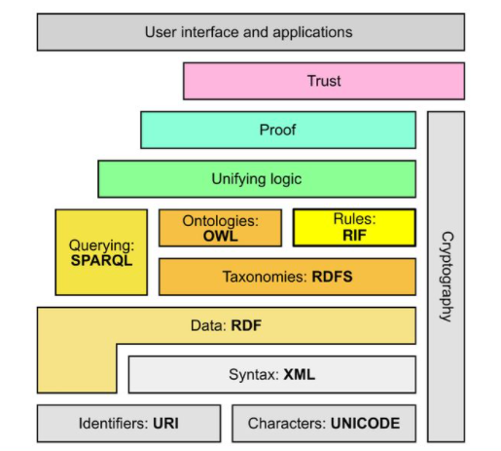
Semantic Web Stack
Provides architecture for the Semantic web and it deals in relationships related to the components.
provides the functions to be used in the components and provides the content structure.
Syntax of the XML is used to provide with the technologies and it provides the process to be made standardized.

Slide 93
RDF and RDFschema.
The RDF family further supports interoperability at the semantic level. RDF developments comprise the base Web language, so that agents, like Pete’s and Lucy’s discussed above, can make logical inferences, based on metadata, to perform tasks.

Slide 94
Logic.
We make logical inferences in our performance of daily tasks. For example: If N denotes new unread email in an email inbox, then if an N appears by a particular message, the message is new unread email. This inference is based on evidence provided by the letter N. The logic layer of the Semantic Web works on this basic principle through First Order Predicate Logic. An agent can derive a logical conclusion (or reason) in the process of completing a task based on what are essentially “facts” rendered from semantically encoded metadata. Other types of logic may also be applicable in the Semantic Web.

Slide 95
Proof and Trust. The last two horizontal layers build off of the logic layer, proof being a validation of the “evidence” stemming from the inferential logic activity and trust relating to the integrity of the proof, which may be traced back down through the other layers in Berners-Lee’s diagram. The functionality of these two layers is highly dependent on creation of accurate and trustworthy metadata.
■ Digital signature. Digital signatures run horizontal to the RDF family up through the proof layer and support the notion of trust. Developments in the area of digital signatures are progressing, and could eventually help validate the integrity of metadata that an agent will use for reasoning and task completion

Slide 96
N-Triples and Turtle

Slide 97
What are the challenges faced by the technology?
Vastness: this includes the large group of pages that is being accessed by the users using the existing technology.
This consists of any automated system that is good in reasoning and deals with the very high inputs.
Vagueness: it occurs due to the queries that are being provided by the content providers.
If the query terms are matched then the knowledge can be combined together to find the knowledge.
Uncertainty: includes uncertain value that can provide the correspondence using the different probability.

Slide 98
Inconsitency: is the very big challenge that provides logical contradictions between the ontologies.
It combines the resources to answer the questions that are being raised by the theories and sources

Slide 99
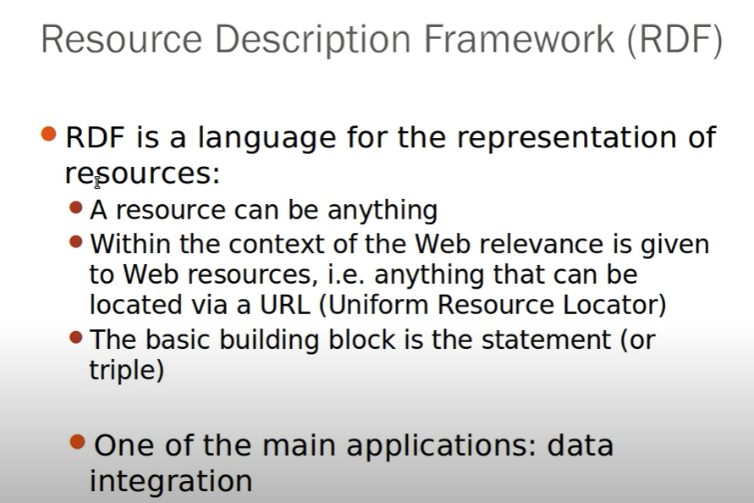




Slide 100
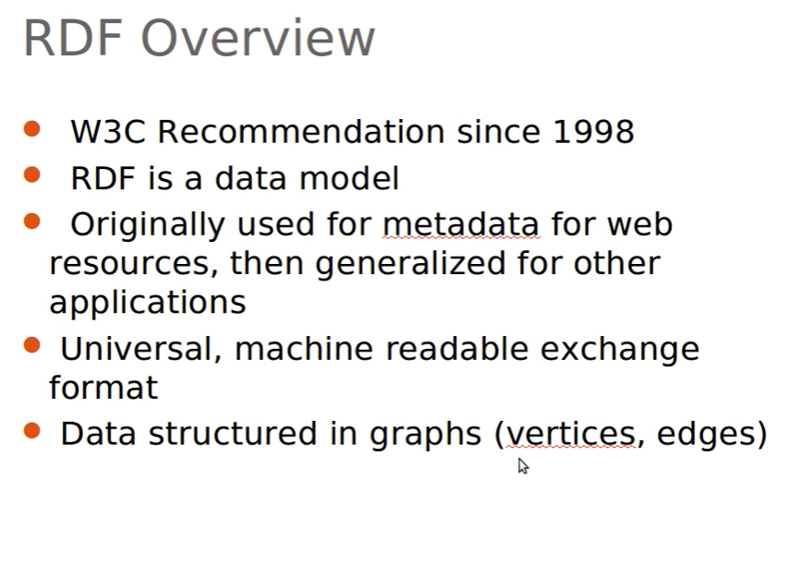

Slide 101
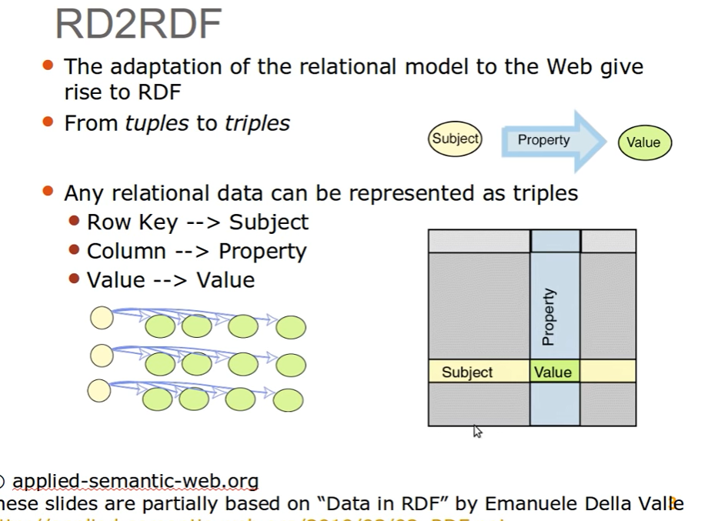
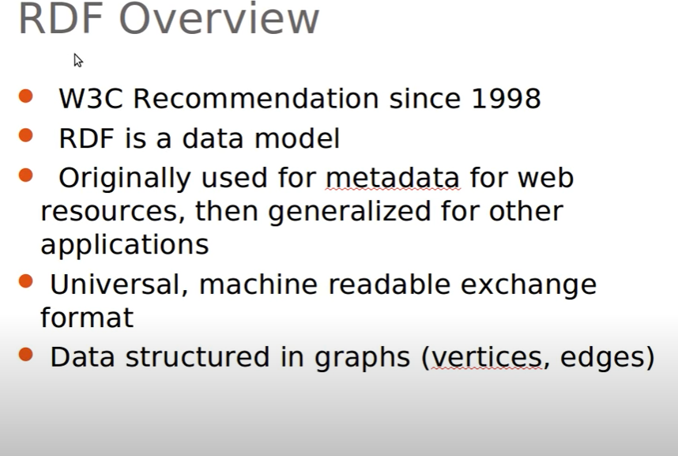

Slide 102
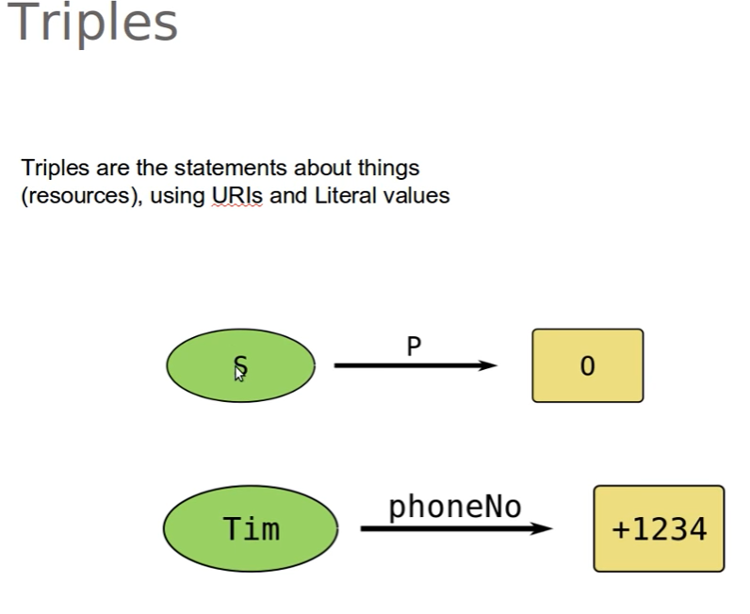

Slide 103
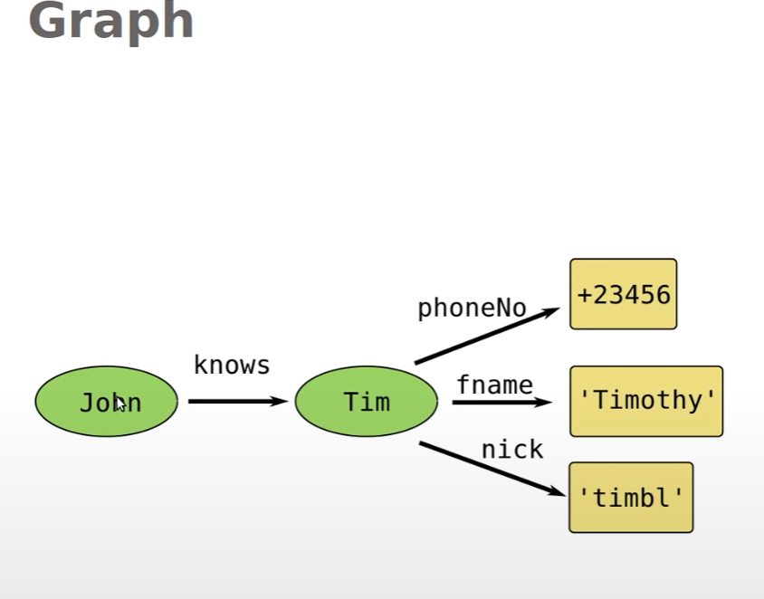

Slide 104
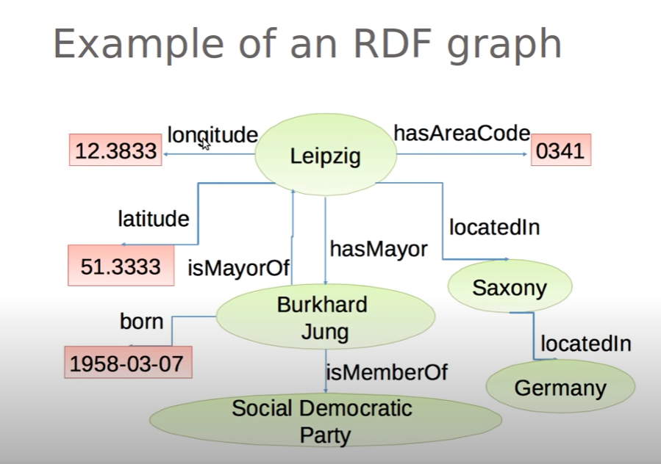

Slide 105
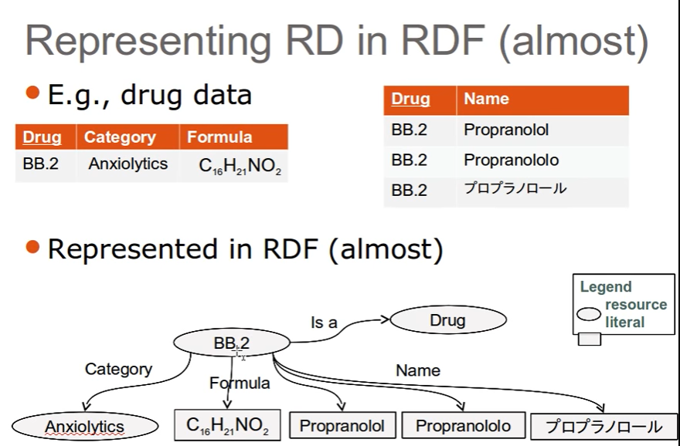

Slide 106
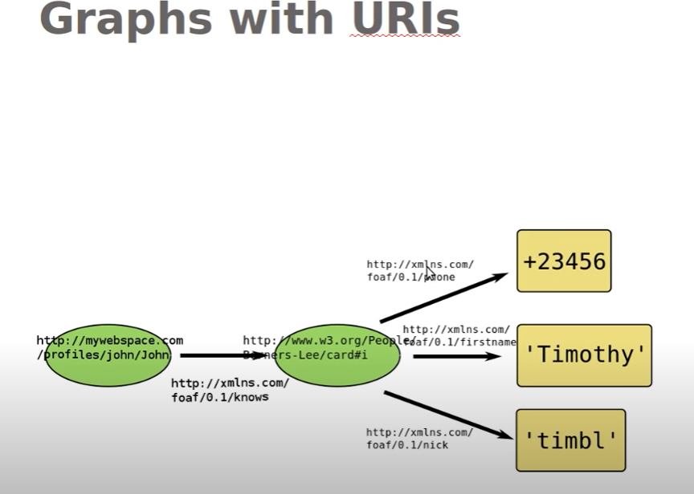

Slide 107
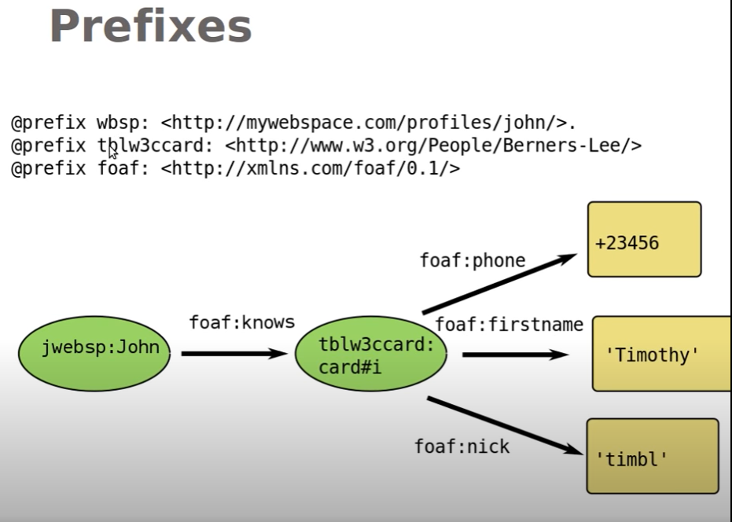

Slide 108
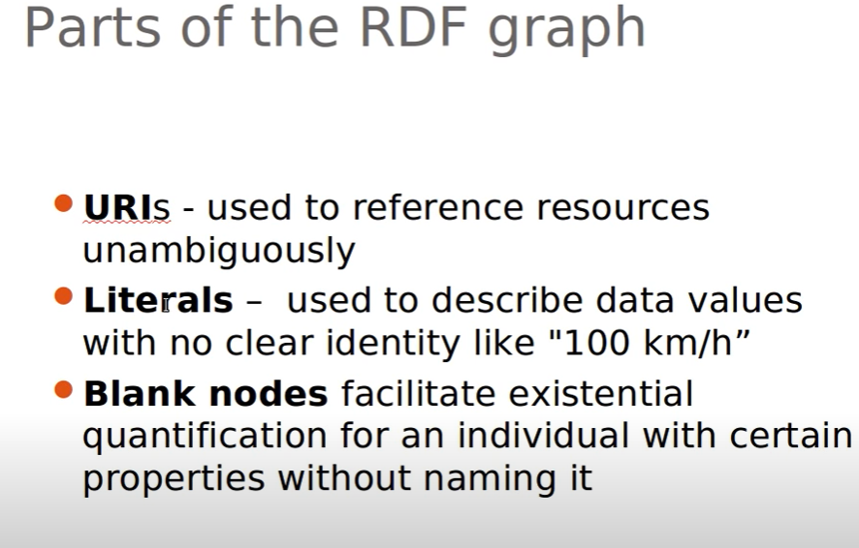

Slide 109
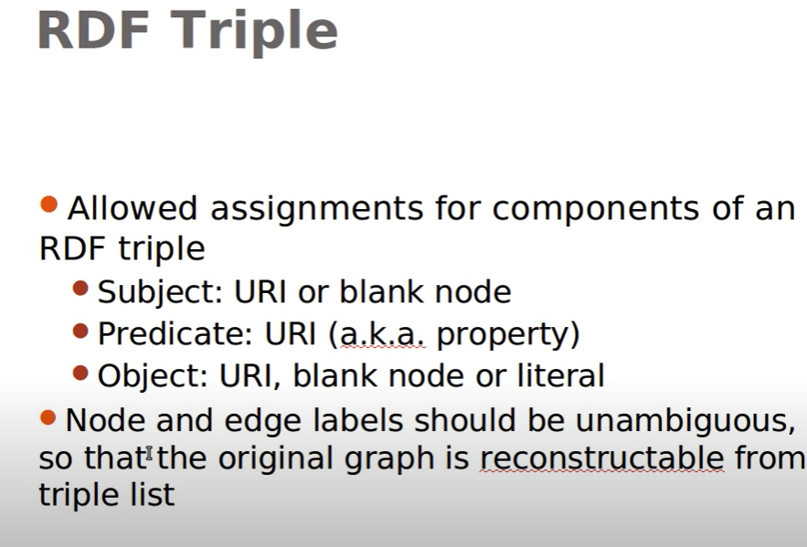

Slide 110
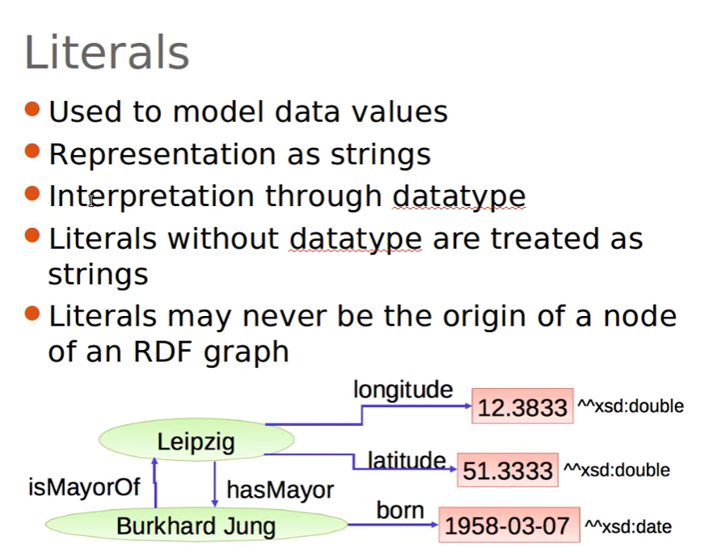

Slide 111
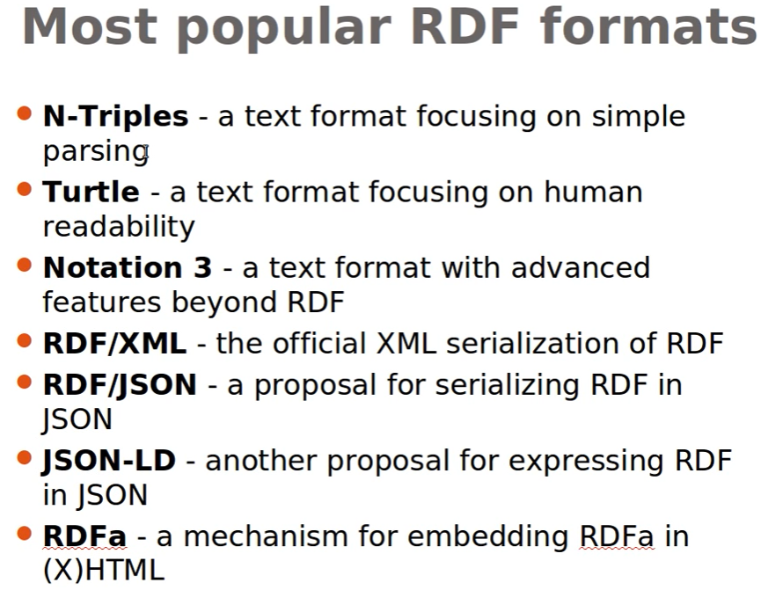

Slide 112
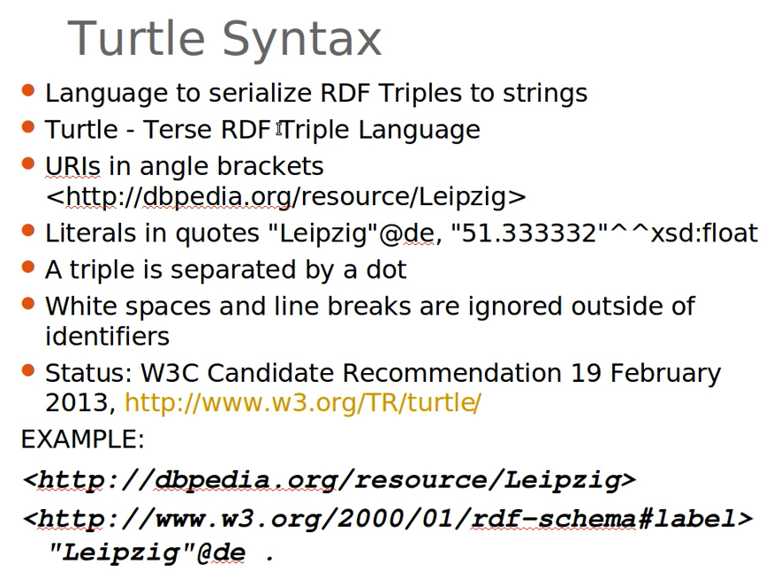
Turtle Format

Slide 113
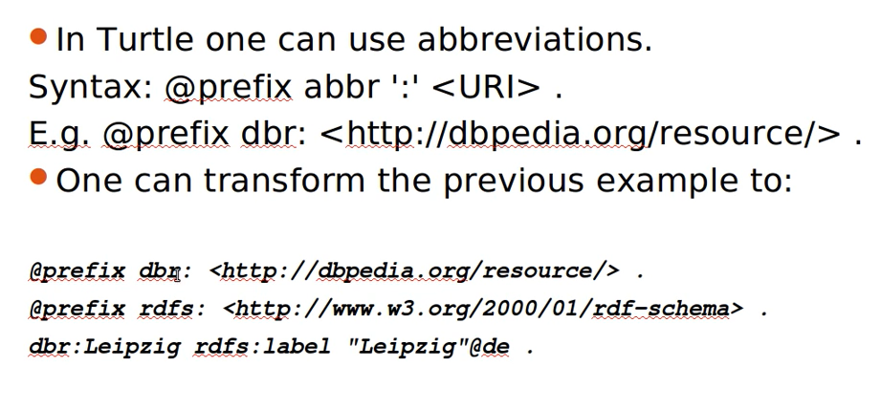

Slide 114
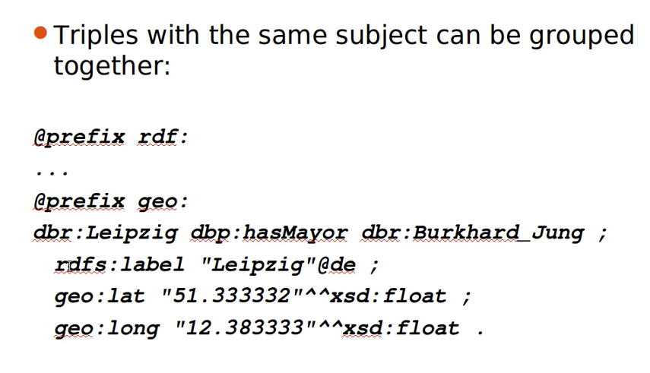

Slide 115
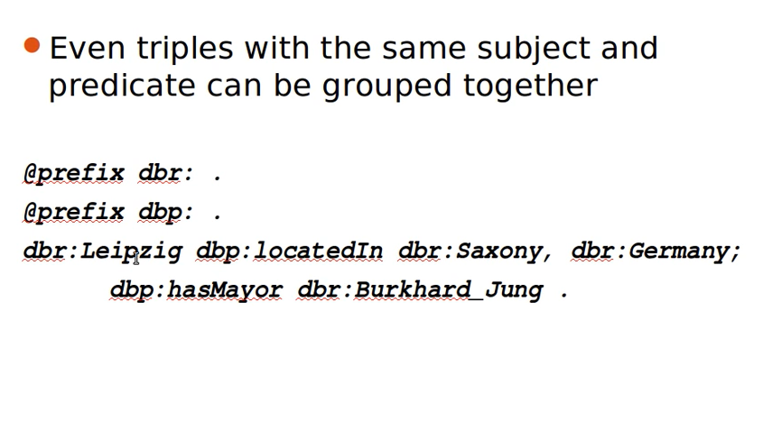

Slide 116
Example
https://www.oreilly.com/library/view/learning-sparql-2nd/9781449371449/ch04.html

Slide 117
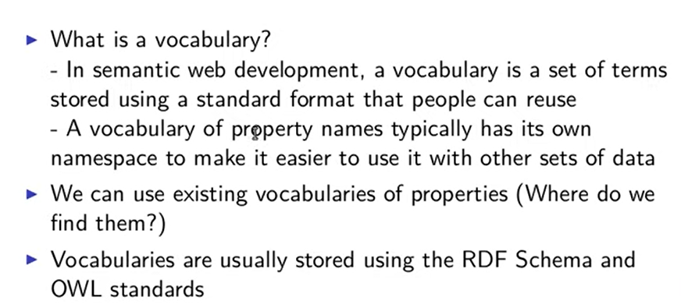
RDFS and OWL

Slide 118
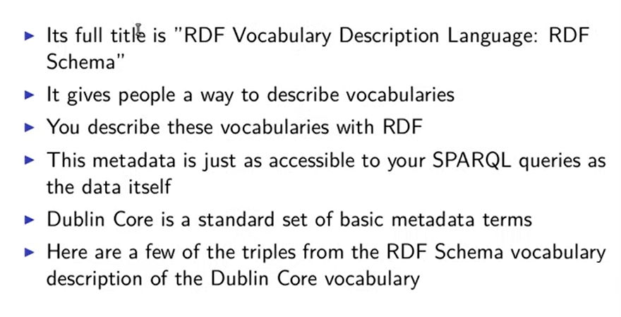

Slide 119
@prefix dc: <http://purl.org/dc/elements/1.1/> .
@prefix rdf: <http://www.w3.org/1999/02/22-rdf-syntax-ns#> .
@prefix rdfs: <http://www.w3.org/2000/01/rdf-schema#> .
dc:creator
rdf:type rdf:Property ;
# a rdf:Property ;
rdfs:comment "An entity primarily responsible for making the resource."@en-US ;
rdfs:label "Creator"@en-US .
Notes:
http://www.learningsparql.com/2ndeditionexamples/ex042.ttl

Slide 120
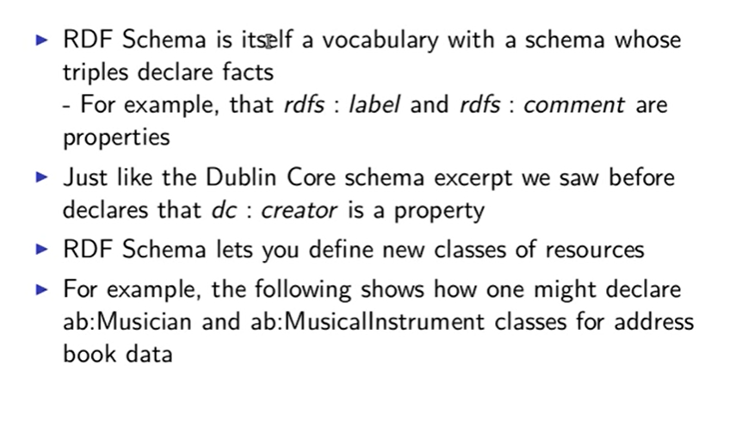

Slide 121
@prefix ab: <http://learningsparql.com/ns/addressbook#> .
@prefix rdf: <http://www.w3.org/1999/02/22-rdf-syntax-ns#> .
@prefix rdfs: <http://www.w3.org/2000/01/rdf-schema#> .
ab:Musician
rdf:type rdfs:Class ;
rdfs:label "Musician" ;
rdfs:comment "Someone who plays a musical instrument" .
ab:MusicalInstrument
a rdfs:Class ;
rdfs:label "musical instrument" .

Slide 122
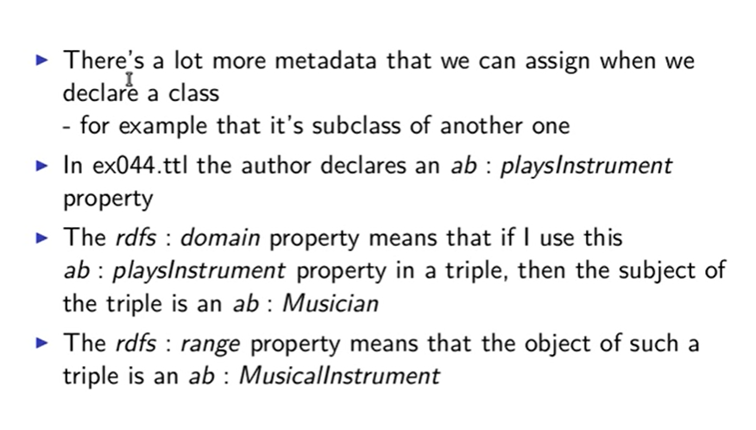

Slide 123
@prefix ab: <http://learningsparql.com/ns/addressbook#> .
ab:i0432 ab:firstName "Richard" ;
ab:lastName "Mutt" ;
ab:postalCode "49345" ;
ab:city "Springfield" ;
ab:homeTel "(229) 276-5135" ;
ab:streetAddress "32 Main St." ;
ab:region "Connecticut" ;
ab:email "richard49@hotmail.com" ;
ab:playsInstrument ab:vacuumCleaner .

Slide 124
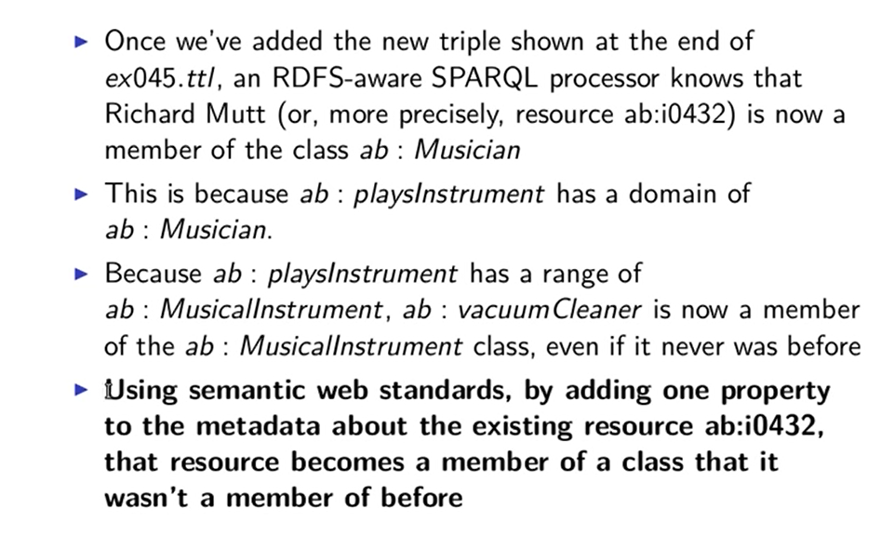

Slide 125
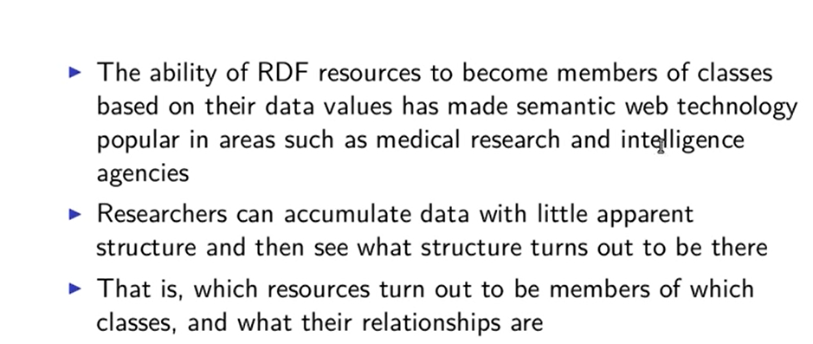

Slide 126
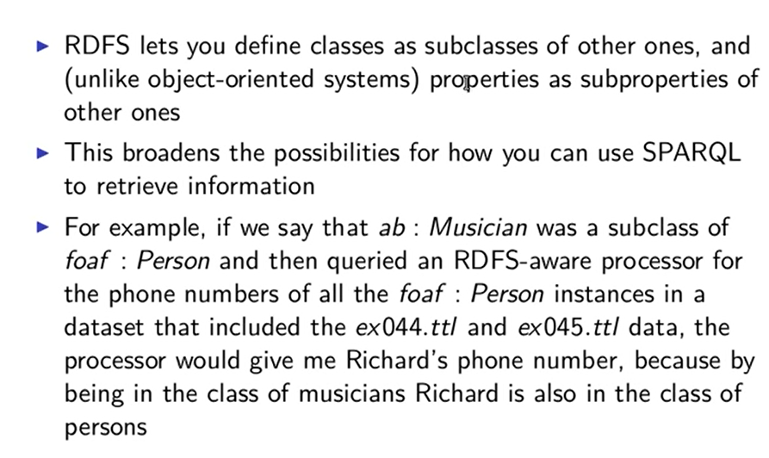

Slide 127

OWL

Slide 128


Slide 129


Slide 130
@prefix ab: <http://learningsparql.com/ns/addressbook#> .
@prefix rdf: <http://www.w3.org/1999/02/22-rdf-syntax-ns#> .
@prefix rdfs: <http://www.w3.org/2000/01/rdf-schema#> .
@prefix owl: <http://www.w3.org/2002/07/owl#> .
ab:i0432
ab:firstName "Richard" ;
ab:lastName "Mutt" ;
ab:spouse ab:i9771 .
ab:i8301
ab:firstName "Craig" ;
ab:lastName "Ellis" ;
ab:patient ab:i9771 .
ab:i9771
ab:firstName "Cindy" ;
ab:lastName "Marshall" .
ab:spouse
rdf:type owl:SymmetricProperty ;
rdfs:comment "Identifies someone's spouse" .
ab:patient
rdf:type rdf:Property ;
rdfs:comment "Identifies a doctor's patient" .
ab:doctor
rdf:type rdf:Property ;
rdfs:comment "Identifies a doctor treating the named resource" ;
owl:inverseOf ab:patient .

Slide 131
Download Protege
https://protege.stanford.edu/products.php#desktop-protege
Notes:
https://www.oreilly.com/library/view/learning-sparql-2nd/9781449371449/ch04.html
http://learningsparql.com/

Slide 132


Slide 133
References

